Slide 1
CIS Foundations of Machine Learning
Chapter 11
Ensemble Methods

Slide 2
References
Chapter 7 of the Hand-On Machine Learning Textbook
https://towardsdatascience.com/ensemble-learning-from-scratch-20672123e6ca
https://towardsdatascience.com/ensemble-methods-bagging-boosting-and-stacking-c9214a10a205
https://towardsdatascience.com/understanding-adaboost-2f94f22d5bfe#:~:text=AdaBoost%20is%20the%20first%20stepping,a%20single%20%E2%80%9Cstrong%20classifier%E2%80%9D.

Slide 3
Outline
Problems with Decision Trees
Random Forest
General Ensemble Methods
Voting
Hard voting vs Soft voting
Bagging and Pasting
Boosting
Ada Boost
Gradient Boost
Stacking

Slide 4
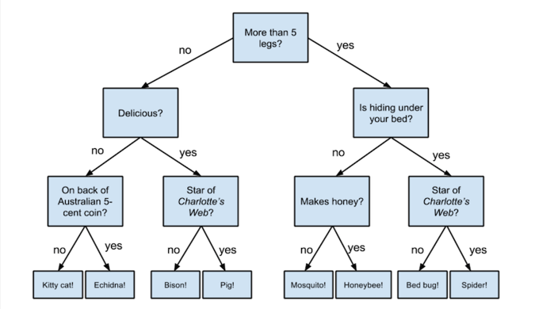
Recap on Decision Trees

Slide 5
Recap on Decision Trees
Fast, Easy to Understand, and often have great accuracy
But it can easily be overfitting

Slide 6
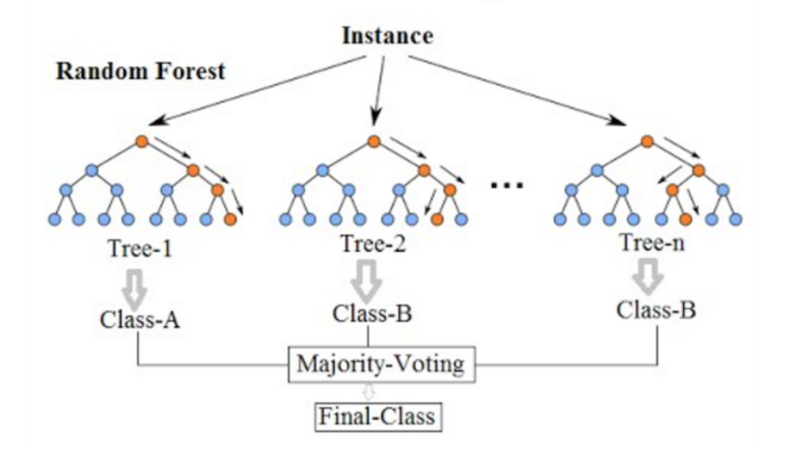
Random Forest to the rescue
Combining weak learners into a strong learner

Slide 7
Ensemble Learning
Random Forest is an example of ensemble learning where predictions from multiple predictors are combined into the final prediction

Slide 8
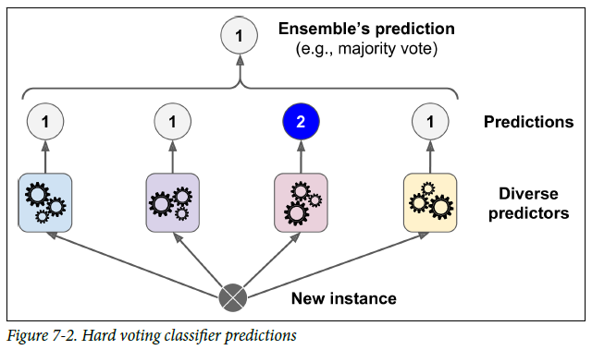
More generally, Ensemble Learning involves Voting Classifiers
Hard voting: pick the prediction with the highest number of votes
Soft voting: combine probabilities of each prediction of each prediction in each model and pick the prediction with the highest total probability
Needs Diverse Predictors

Slide 9

Random Forest is a perfect example of democracy
Everybody loves democracy

Slide 10
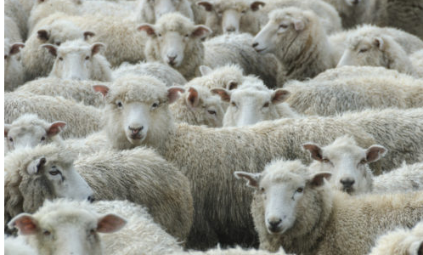
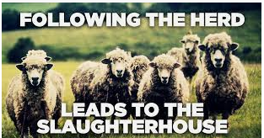
Voting Classifiers
Any problems with voting and decisions by majority?
What if most weak learners are almost the same
Following the herd.

Slide 11


Essence of Ensemble Learning
Random Forest depends on random selection of training dataset which does guarantee some diversity, but may not be enough
Make the best use of diversity
Strategic Selection of training data
Rely on the Wisdom of the Crowd

Slide 12
Democracy needs Diversity and Independence
Ensemble methods work best when the predictors are as independent from one another as possible.
One way to get diverse classifiers is to train them using very different algorithms. This increases the chance that they will make very different types of errors, improving the ensemble’s accuracy

Slide 13
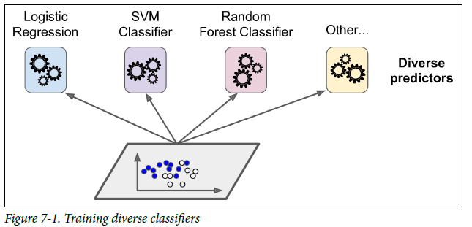
Voting Classifiers with different algorithms to achieve diversity

Slide 14
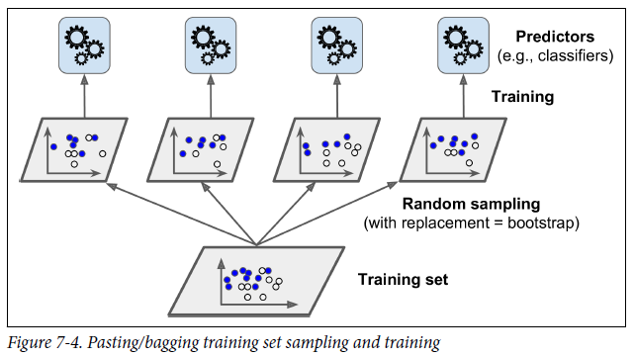
Other techniques to achieve better performance
Bagging and Pasting: Use same training algorithm, but on different training set. When sampling is performed with replacement, this method is called bagging (bootstrap aggregating). When sampling is performed without replacement, it is called pasting.
Learning process in both methods can be run independently from each other in parallel
Random Forests is an ensemble of Decision Trees, generally trained via the bagging method.

Slide 15
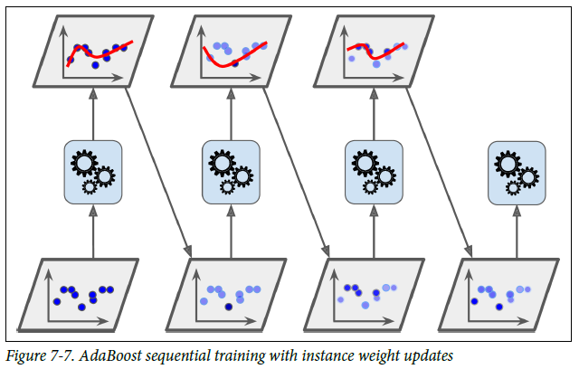
Building models sequentially; Next improves from the previous version
Boosting: any ensemble method that can combine several weak learners into a strong learners. Most boosting methods is to train predictors sequentially, each trying to correct its predecessor.
AdaBoost: Focus on the cases where the predecessor fail by giving more weights to the mis-classified training instances.
Gradient Boosting: Instead of changing weights, it try to fit the residual errors made by the previous predictor in the next iteration.

Slide 16
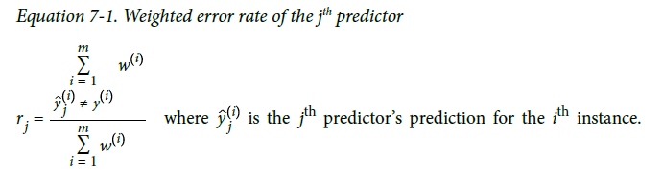
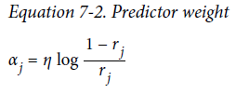
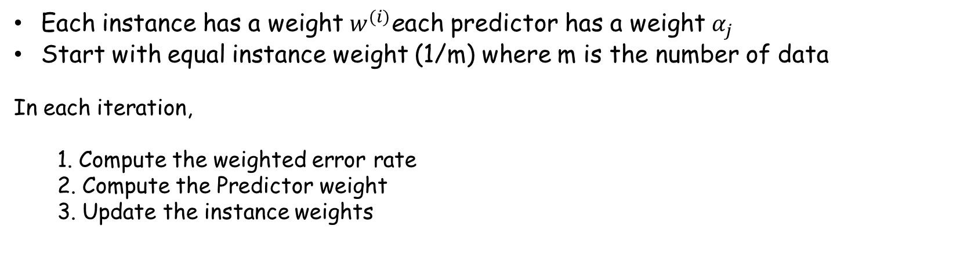
AdaBoost
Each instance has a weight $w^{(i)}$each predictor has a weight $α_{j}$
Start with equal instance weight (1/m) where m is the number of data
In each iteration,
1. Compute the weighted error rate
2. Compute the Predictor weight
3. Update the instance weights
η is the learning rate, which will determine how fast the algorithm will converge, similar to the learning rate in Gradient descent

Slide 17
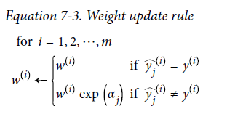
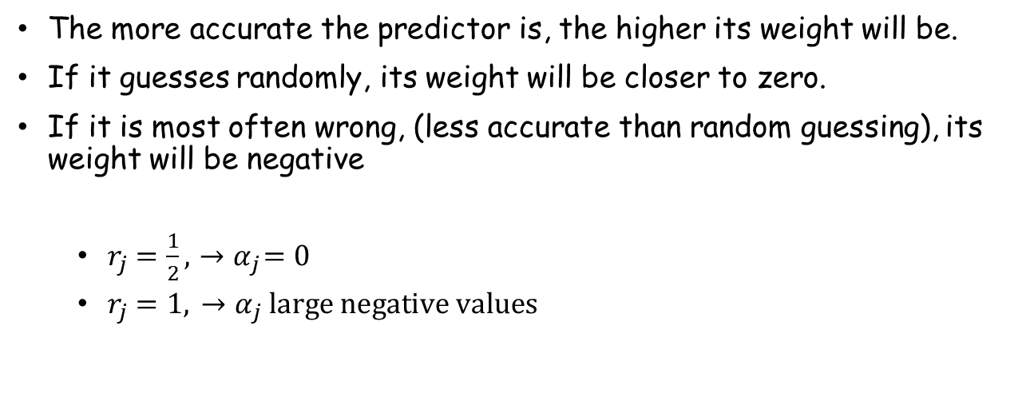
AdaBoost Intuition
The more accurate the predictor is, the higher its weight will be.
If it guesses randomly, its weight will be closer to zero.
If it is most often wrong, (less accurate than random guessing), its weight will be negative
$r_{j}=\frac{1}{2},{ →α}_{j}=0$
$r_{j}=1,{ →α}_{j} large negative values$
Instance weights are boosted for misclassified instances

Slide 18
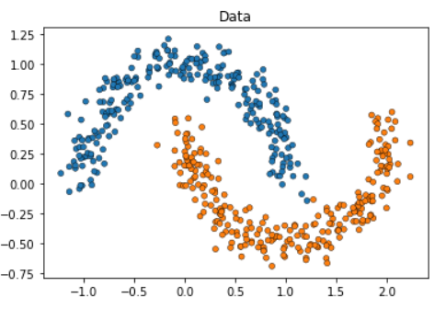
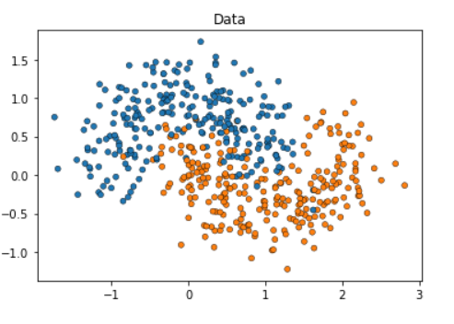
AdaBoost applied to make_moons dataset
Make_moons dataset is an artificially generated dataset meant for testing Machine Learning algorithms

Slide 19
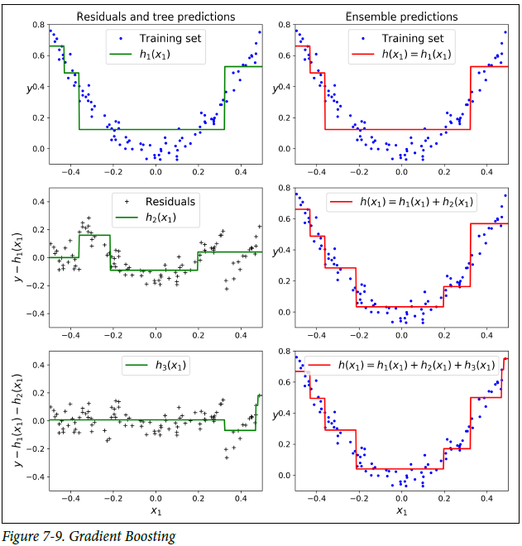
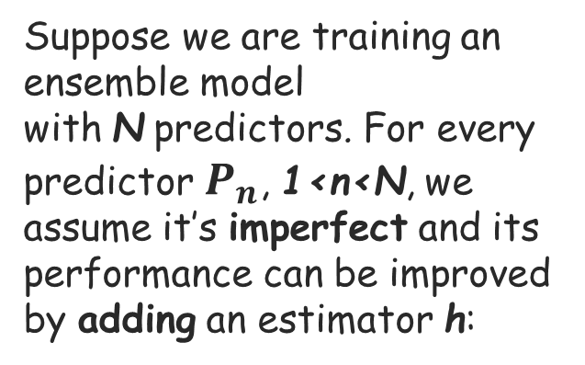

Gradient Boosting
Suppose we are training an ensemble model with N predictors. For every predictor $P_{n}$, 1<n<N, we assume it’s imperfect and its performance can be improved by adding an estimator h:
$$P_{n+1}\left(x\right)=P_{n}\left(x\right)+h(x)$$

Slide 20



Gradient Boosting
$$P_{n+1}\left(x\right)=P_{n}\left(x\right)+h(x)$$
Now, to find h we start by looking at how a perfect h would be:
or
Also, remember Taylor expansion to approximate a function?
F(x) = 1st order + 2nd order + 3rd order + …

Slide 21
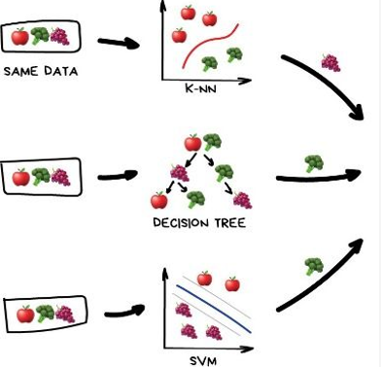
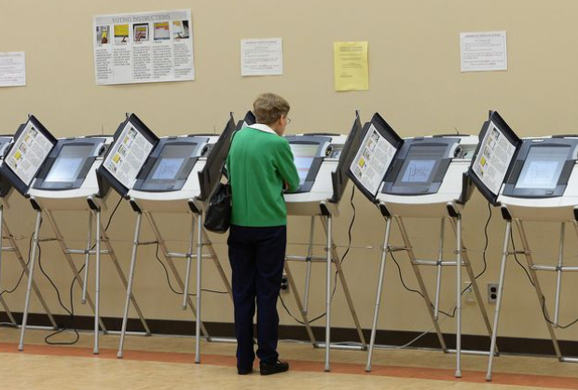
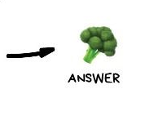
Voting Machine
Can we do better than just use a simple majority in our final step?

Slide 22
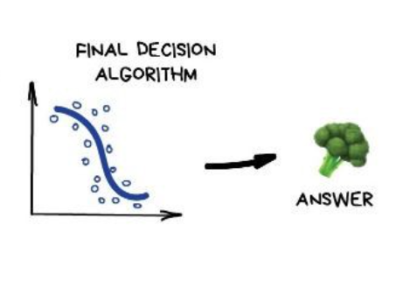
Stacking
Build a model for the final decision step

Slide 23
Learning by doing

